Slide 1


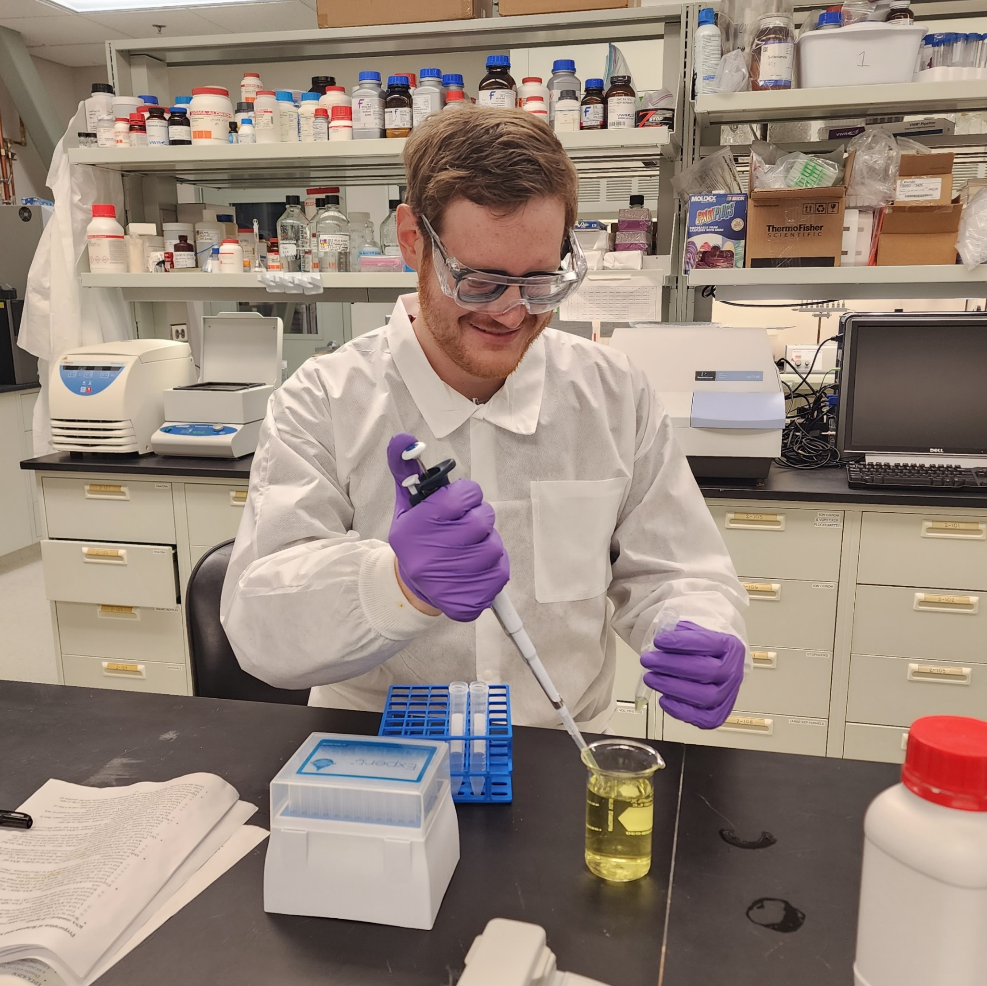
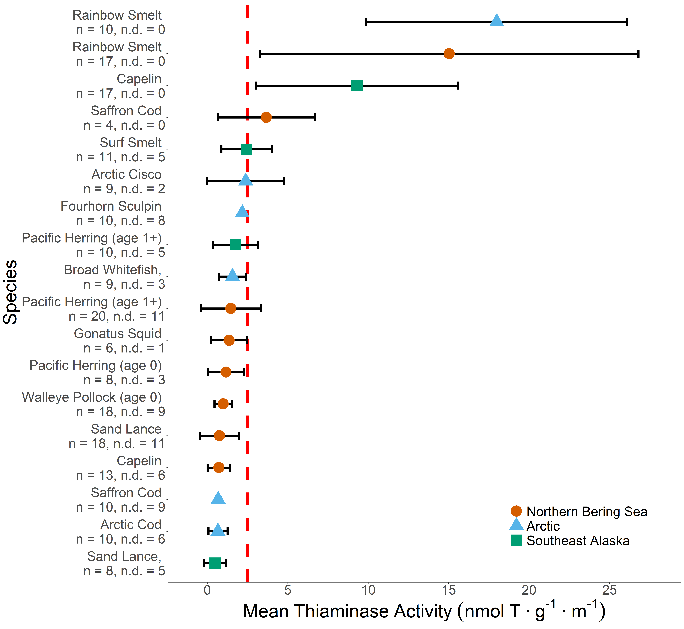
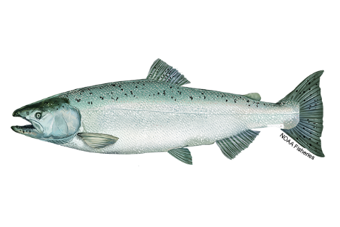
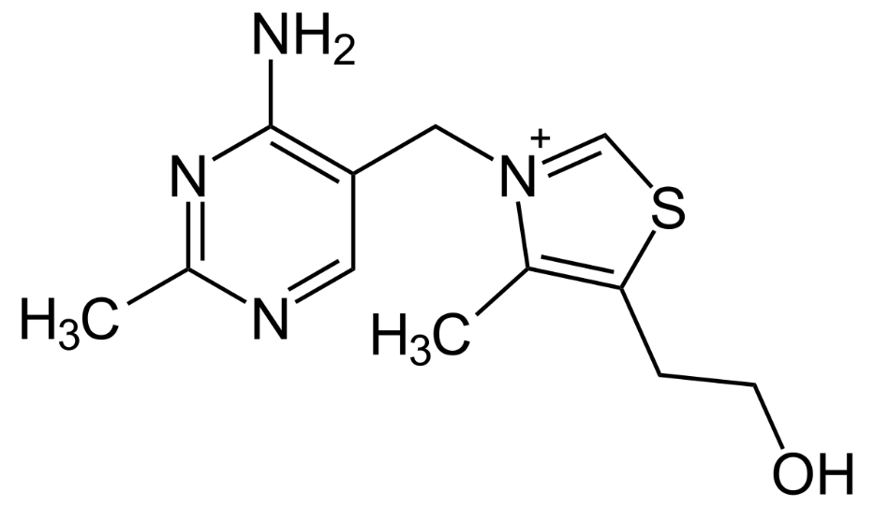
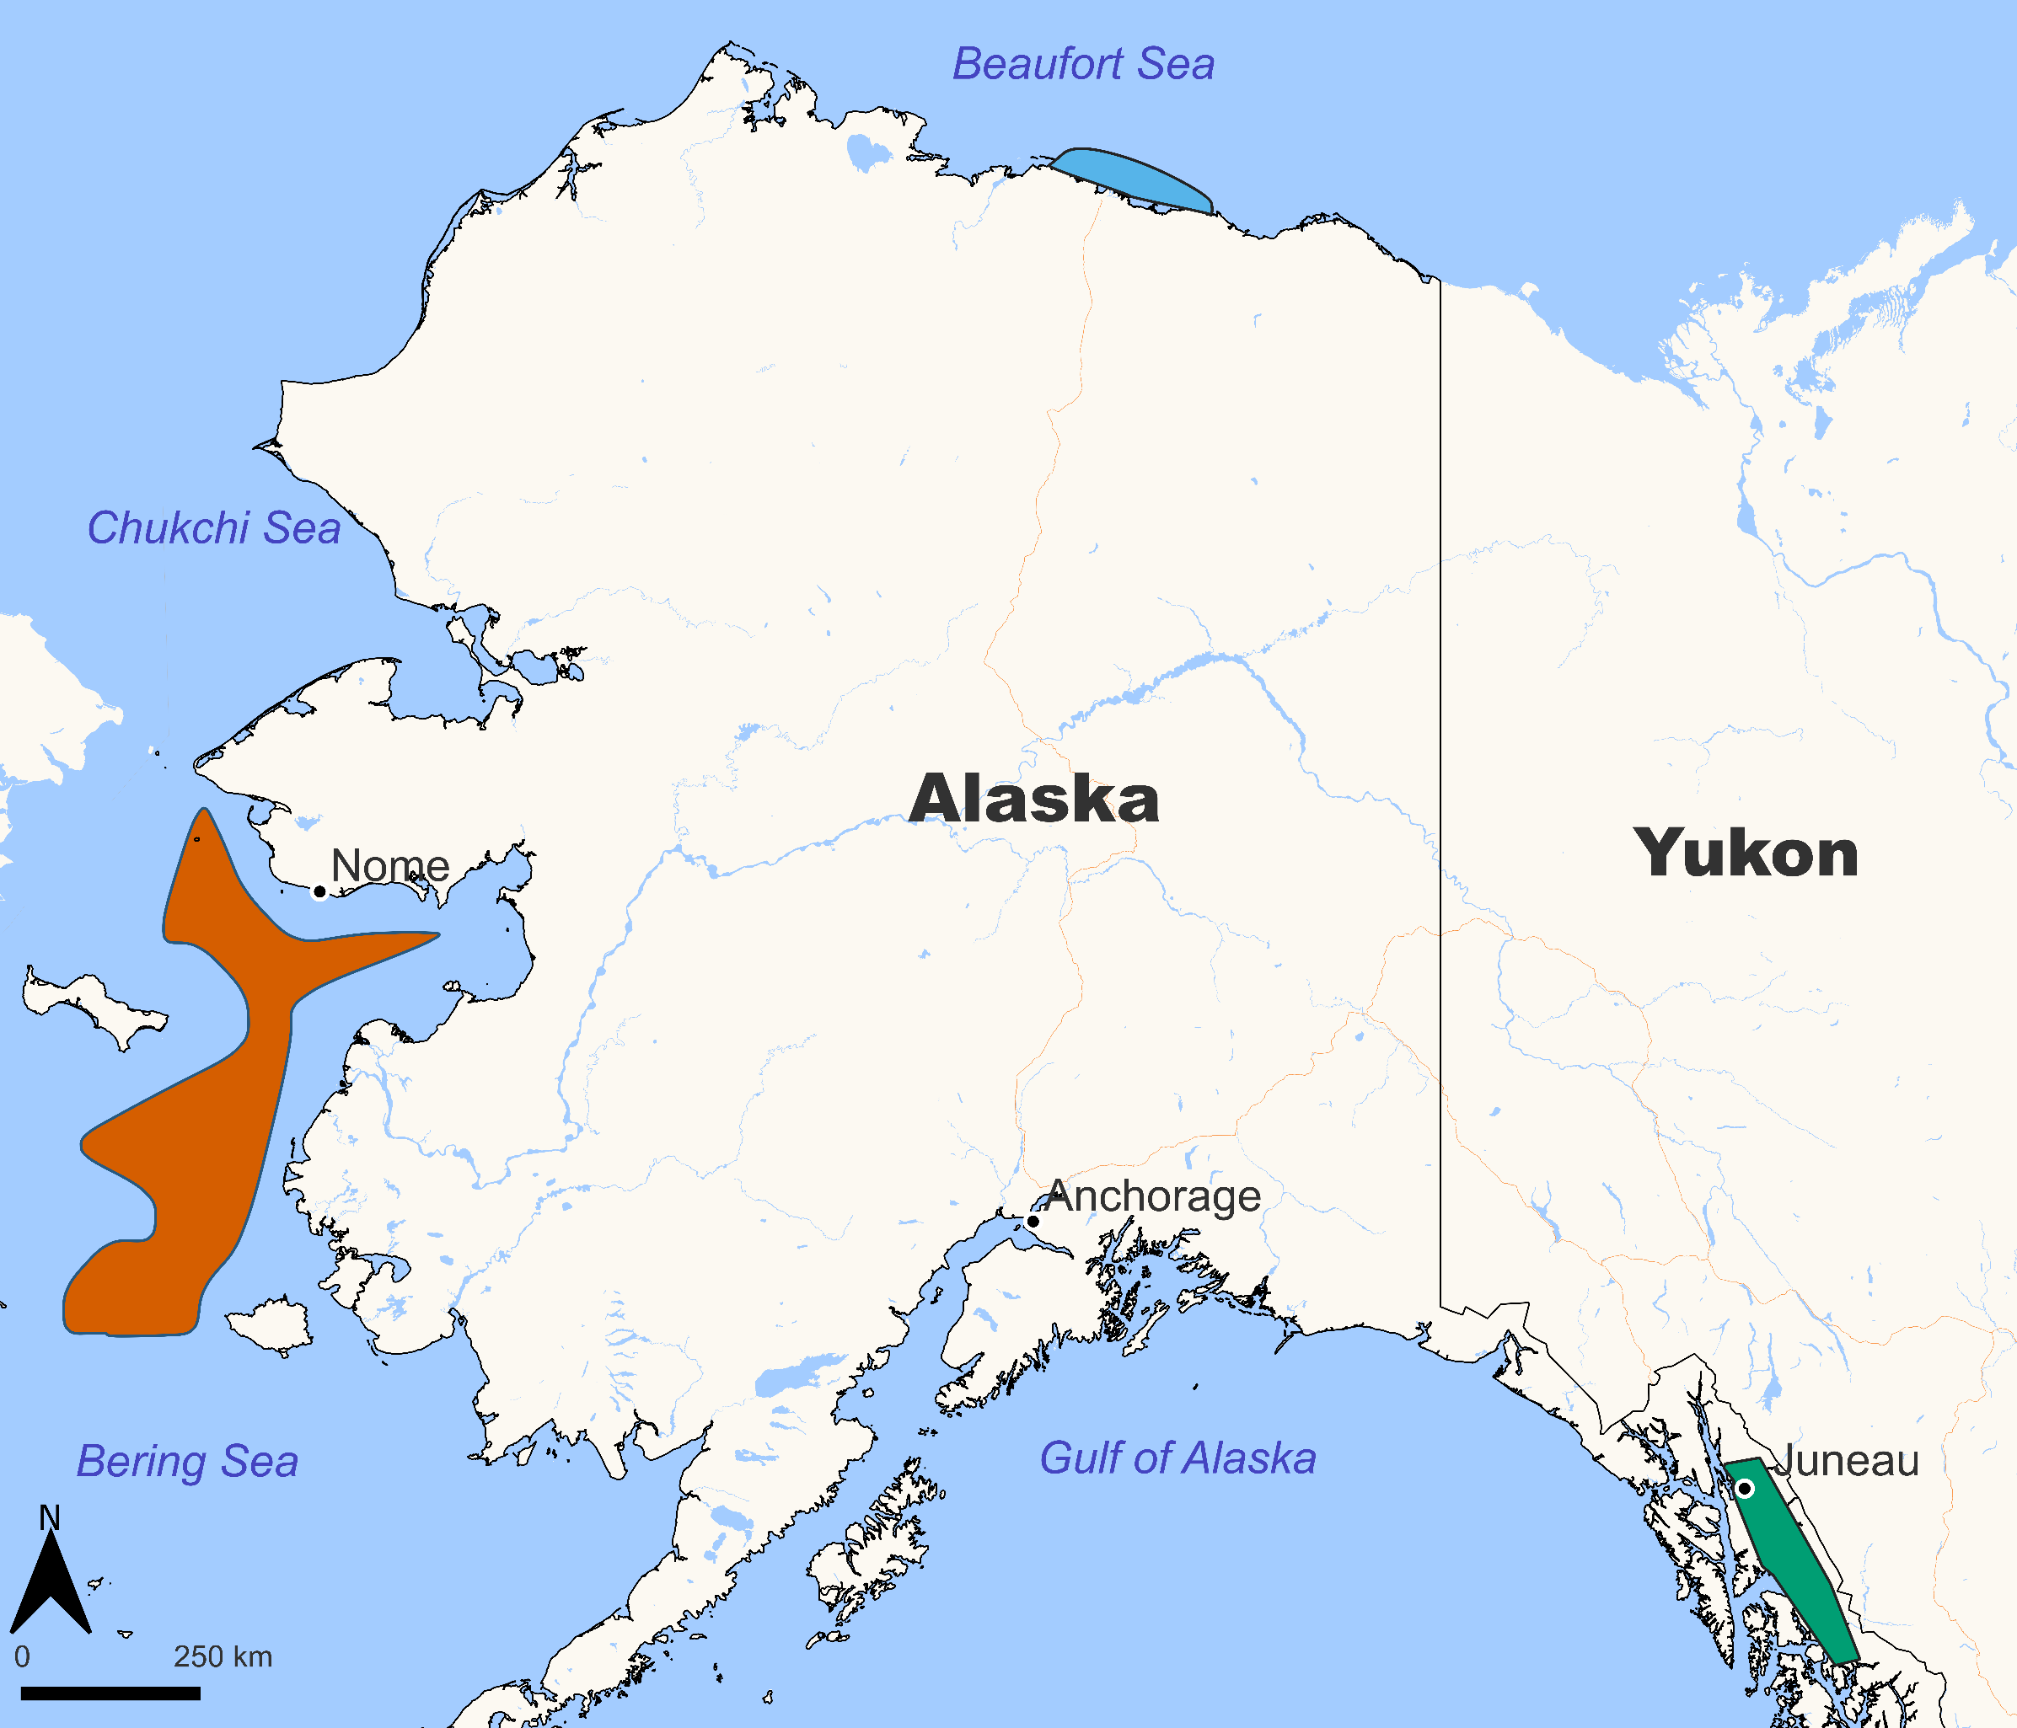
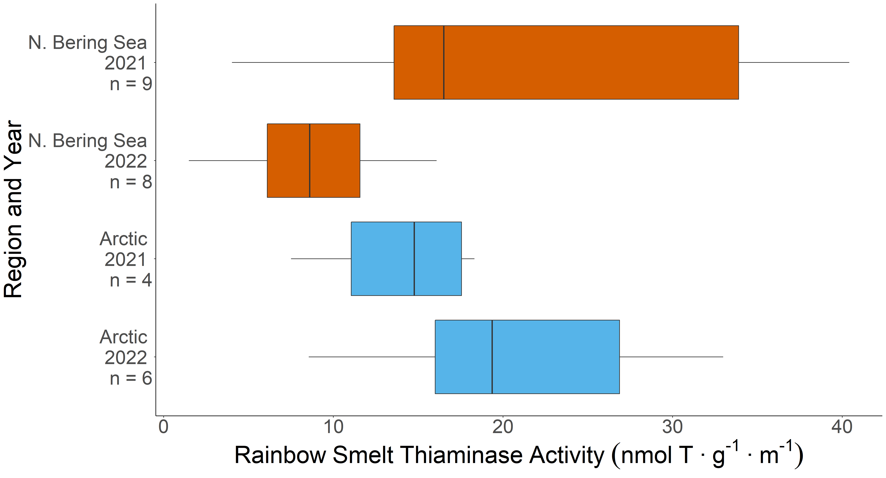
Thiaminase Activity in Alaskan Forage Fishes
Drew Porter^{1,3}, Kathrine Howard², Cody Pinger³
¹Alaska Sea Grant, ²Alaska Department of Fish and Game, ³Alaska Fisheries Science Center, NOAA/NMFS
Correspondence: drew.porter@noaa.gov
OVERVIEW
RESULTS
Thiamine (i.e., vitamin B1) is an essential enzyme co-factor for cell metabolism that must be obtained through diet.
Thiamine deficiency complex has been attributed to early life stage mortality and population declines in salmonids from the Laurentian Great Lakes, California’s Central Valley, and the Baltic Sea.
Thiamine deficiency complex in salmon is hypothesized to be caused by consumption of prey containing thiaminase, an enzyme that destroys thiamine.
Chinook Salmon (Oncorhynchus tshawytscha) populations in Alaska have undergone significant declines and reduced productivity in recent years.
Deficient levels of thiamine have been measured in eggs and muscle tissue of Chinook Salmon from both Southeast Alaska (unpublished) and the Yukon River.¹
To date, thiaminase activity has not been measured in Alaska forage fish that potentially serve as prey for Chinook Salmon.
METHODS
Frozen fish samples were homogenized and analyzed for thiaminase activity (expressed as nanomoles of thiamine degraded per gram per minute) using the spectrophotometric 4-nitrothiophenol assay.³
MAIN FINDINGS
Rainbow Smelt (Osmerus mordax dentex) displayed the highest thiaminase activity overall and displayed regional and interannual variability, consistent with trends observed elsewhere.⁴
Capelin (Mallotus villosus) from Southeast Alaska had much higher thiaminase activity levels than individuals from the Bering Sea did. Notably, these populations are genetically distinct.⁵
Thiaminase activity varied by species, region, and year. Several purported prey species of Chinook Salmon displayed thiaminase activity above a threshold level known to cause thiamine deficiency in consumers.
Thiamine
Chinook Salmon
OBJECTIVE
NEXT STEPS
Measure thiaminase activity in forage fish species collected from three different Alaska marine ecosystems.
Measure these individuals for total body thiamine and lipid content to gain greater insight into prey quality in Alaska marine environments.
Further investigate the observed interannual variability of thiaminase activity within species by analyzing archived individuals and individuals collected in subsequent years.
Assess survey abundance of forage fishes with prey quality data to develop a spatial understanding of how thiaminase positive prey species are distributed in Alaska marine environments.
COLLECTION AREAS
Figure 2. Mean thiaminase activity measured in species collected from Alaska marine ecosystems. Error bars = ± 1 standard deviation, n = sample size, n.d. = samples with no detectable thiaminase activity, red line = thiaminase activity threshold (>2.5 nmol T∙g⁻¹∙m⁻¹) observed to cause thiamine deficiency in consumers.²
ACKNOWLEDGEMENTS
We thank B. Cormack for assistance with the thiaminase assay. Thank you to J. Murphy and W. Strausburger for their insights and expertise. We appreciate the numerous individuals who assisted with field collection of fish samples, including D. Neff, J. Moran, W. Licht, E. Piatt, S. King, F. Sewall, M. Arimitsu, the RECA group, and all those on the Northern Bering Sea survey. Fish samples from the Arctic were provided by V. von Biela (USGS).
REFERENCES
¹Larson, S., & Howard, K. (2019). Alaska Department of Fish and Game, Fishery Data Series No. 19-22, Anchorage.
²Honeyfield, D. C., et al. (2016). North Pacific Anadromous Fish Commission, Bulletin No. 6, 21–31.
³Kraft, C. E., et al. (2014). PLoS ONE, 9(3), e92688.
⁴Tillitt, D. E., et al. (2005). Journal of Aquatic Animal Health, 17(1), 13–25.
⁵Dodson, J. J., et al. (2007). Molecular Ecology, 16(23), 5030–5043.
Figure 1. Collection areas for Alaska forage fish species. Fish were collected from the Northern Bering Sea (orange), the Arctic (blue), and Southeast Alaska (green).
Figure 3. Thiaminase activity measured in Rainbow Smelt collected from two Alaska marine ecosystems over two years.
The recommendations and general content presented in this poster do not necessarily represent the views or official position of the Department of Commerce, the National Oceanic and Atmospheric Administration, or the National Marine Fisheries Service.
Notes:
Notes:
In Powerpoint, click View > Guides
Keep text within gutter guides.
Author list: Don’t split names onto two lines (e.g., “Jimmy [break] Smith”). If that happens, use a new line, unless you need the space. Bold the first names of anybody who’s presenting in person.
Intro/methods/result: Do not drop below font size 28, but if you have extra space, jack up the font size until the space is full.
Do not use color in the sidebars except in graphs/figures. It’ll pull attention from the center and slow interpretation for passersby.

